Slide 1



ANTIDOTE
TEAM MEMBERS :
MONIC AUDITYA A.
MONISH D.Y.
MOKESH M.
MOHAMED IKRAM K.H.D.
MITHUN A.R.

Slide 2
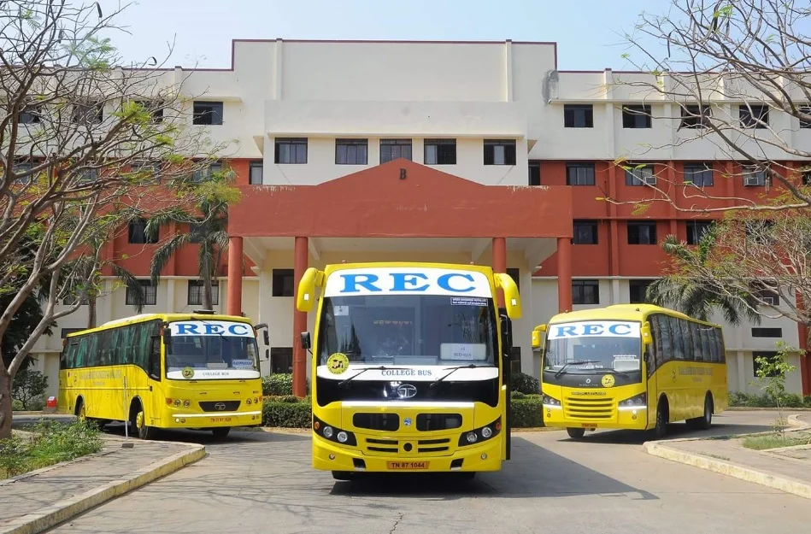

BUS MANAGEMENT SYSTEM
Efficient bus transportation is
crucial for students and faculty.
Existing systems lack real-time tracking, leading to delays and miscommunication.
Our system provides real-time
tracking, better communication,
and route management.

Slide 3

Existing System and its Disadvantages
1. Chalo
Present: Live tracking, ETA.
Missing: Campus routes, Safety, Chat, Recommendations, Optimization, Alerts.
2. RedBus
Present: ETA.
Missing: Live tracking, Campus routes, Safety, Chat, Recommendations, Optimization, Alerts.
3. Moovit
Present: ETA.
Missing: Live tracking, Campus routes, Safety, Chat, Recommendations, Optimization, Alerts.

Slide 4
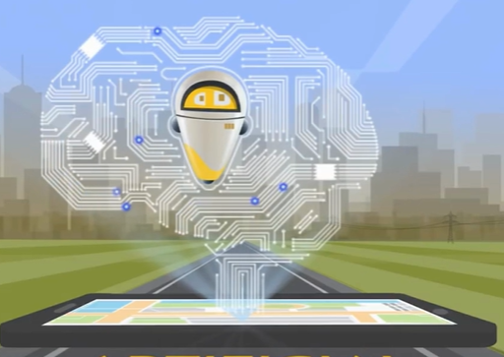
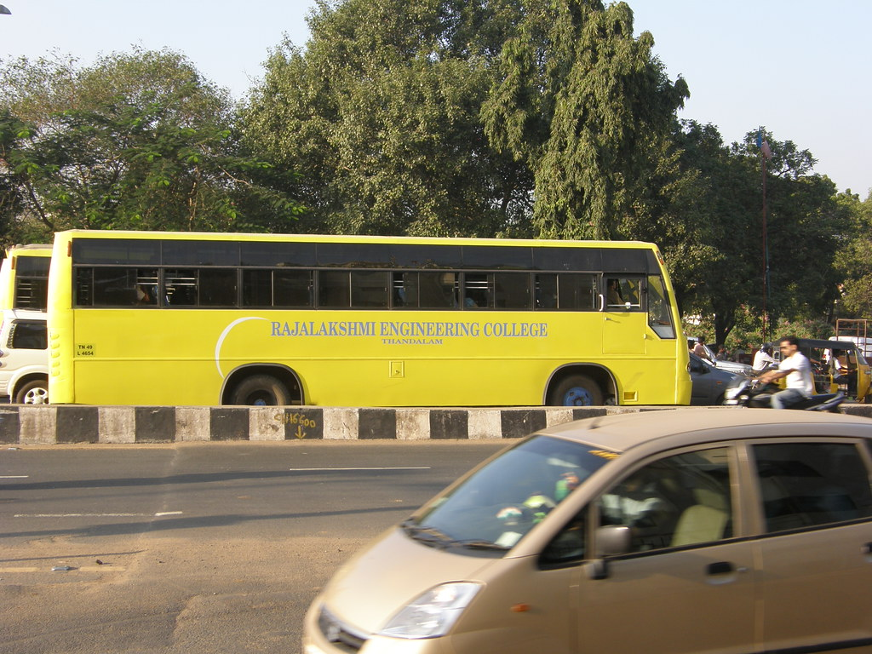
4. NeoTrack
Present: Live tracking, ETA, Campus routes, Safety, Chat, Optimization.
Missing: Recommendations, Alerts.
5. Saveetha Bus App
Present: Campus routes.
Missing: Live tracking, ETA, Safety, Chat, Recommendations, Optimization, Alerts.
6. REC Transport App
Present: Campus routes.
Missing: Live tracking, ETA, Safety, Chat, Recommendations, Optimization, Alerts.

Slide 5
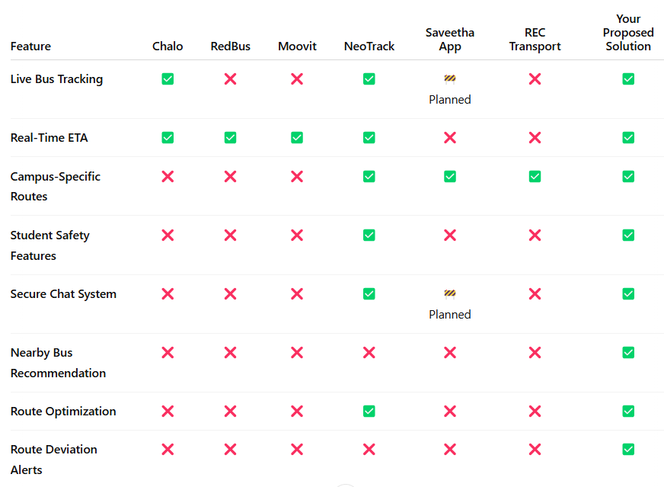

Slide 6

Proposed Solution – System Features
How Our System Solves These Problems :
Live Bus Tracking – Uses driver’s mobile GPS to update real-time locations.
Predefined Stops & Routes – Displays estimated arrival times for better planning.
Secure Chat System – Enables direct communication between students and drivers.
Nearby Bus Recommendation – Suggests the best available bus based on the user's location.
Route Deviation Alerts – Sends notifications if the bus goes off-route.
Dual Interface:
Student & Faculty Interface – View buses, check routes, chat with drivers, and receive alerts.
Driver Interface – GPS tracking, route management, and communication options.

Slide 7

Advantages of Our System
Why Our System Stands Out :
✅ Cost-Effective – Uses existing mobile GPS, eliminating extra hardware costs.
✅ Improved Efficiency – Real-time tracking minimizes delays and confusion.
✅ Enhanced Communication – Secure chat feature bridges the gap between users and drivers.
✅ Better Planning – Estimated arrival times help students and faculty manage their schedules.
✅ Increased Safety – Route deviation alerts ensure safer and more reliable travel.

Slide 8
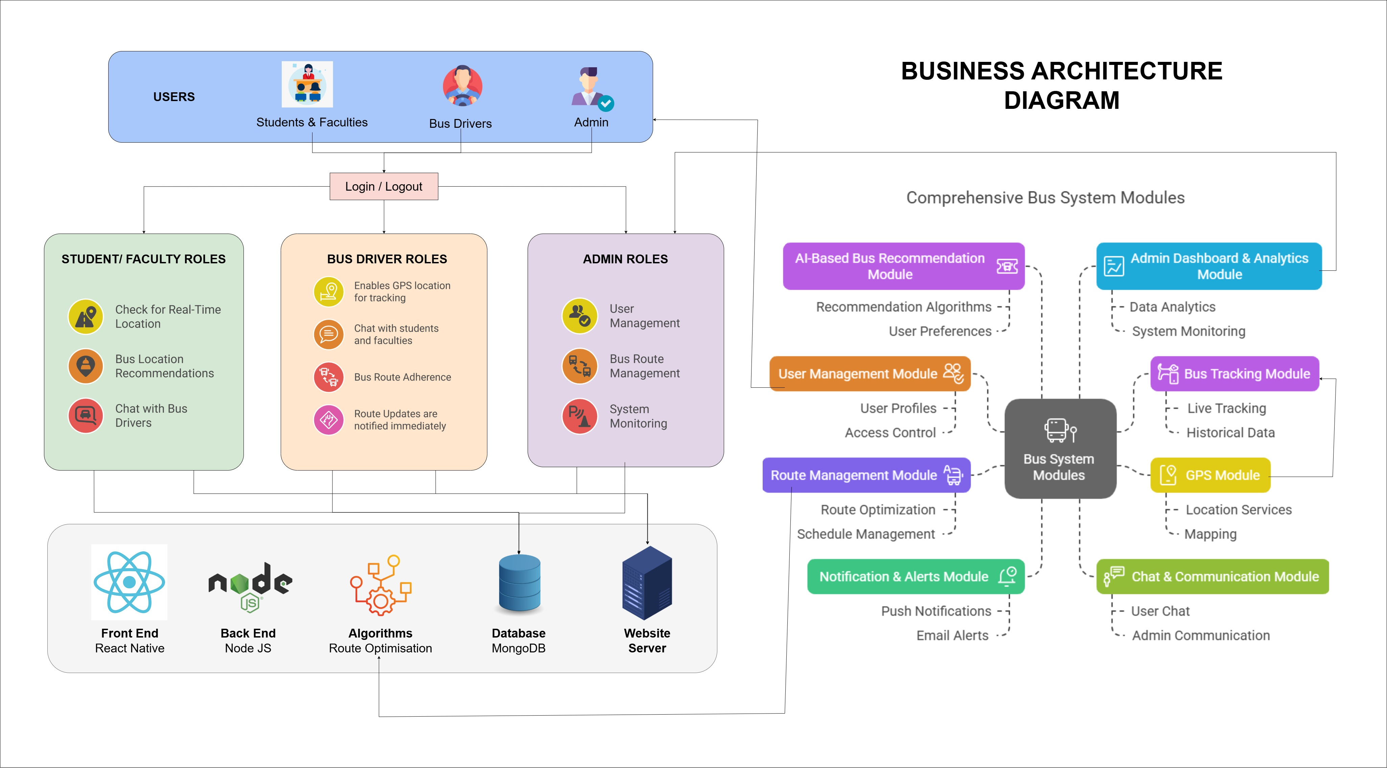
Business Architecture Diagram

Slide 9
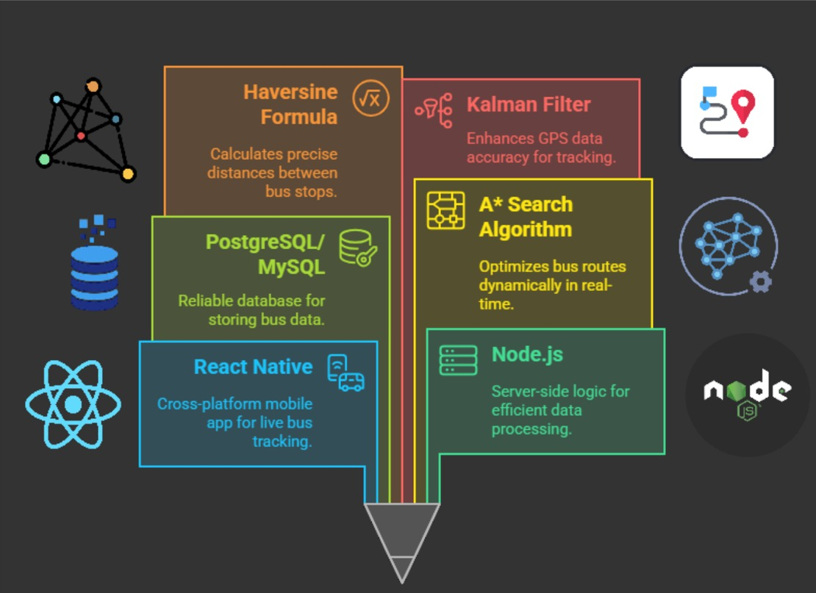
Tech
Stack

Slide 10
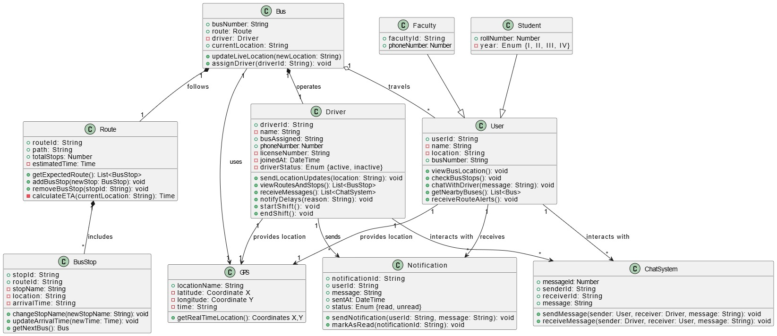
Class Diagram

Slide 11
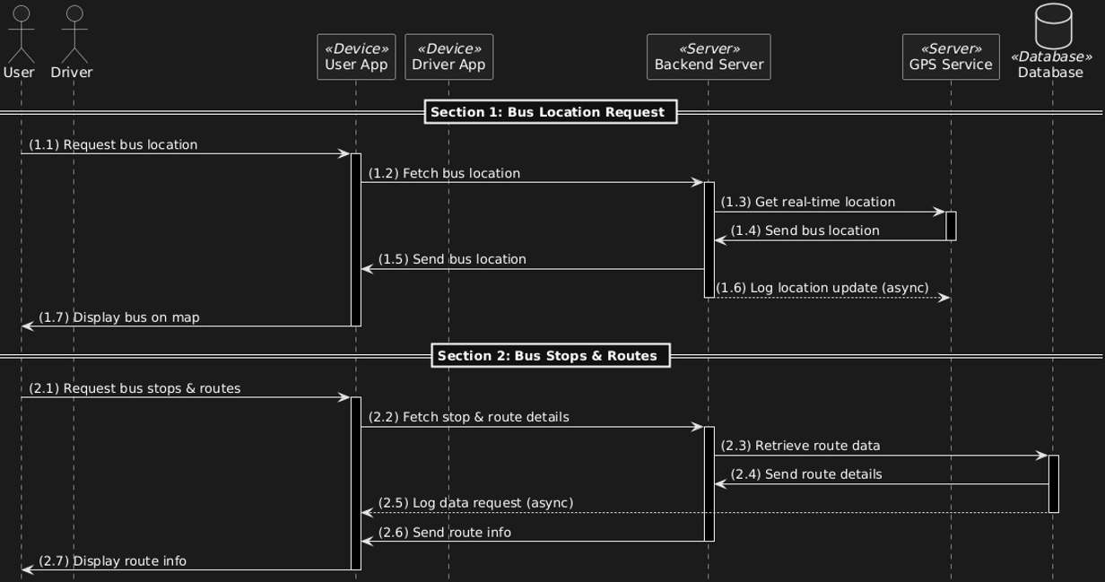
Sequence Diagram

Slide 12
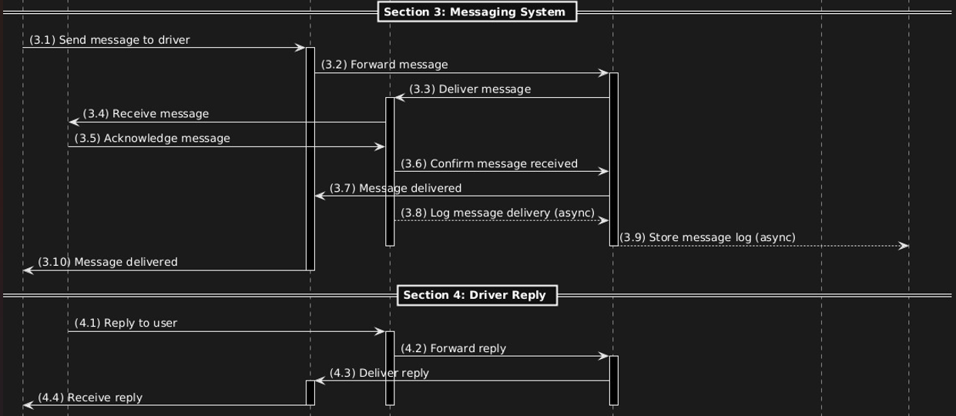

Slide 13
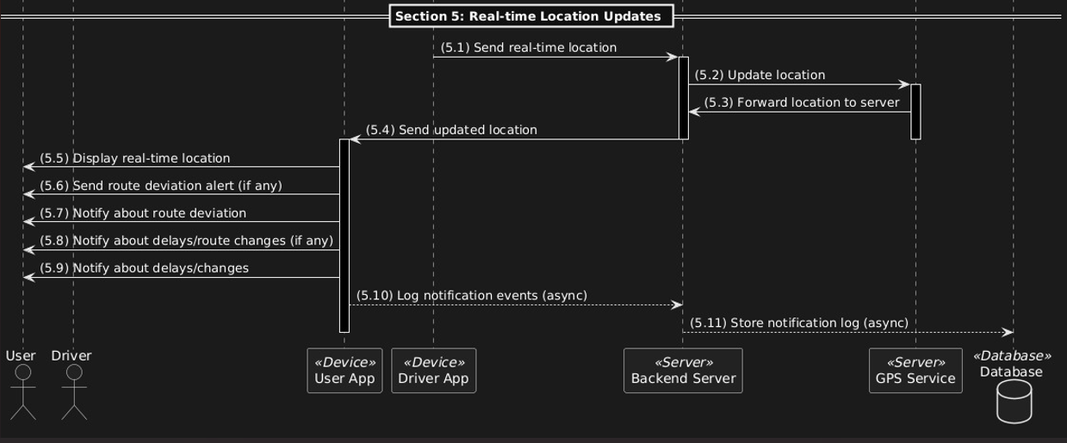

Slide 14
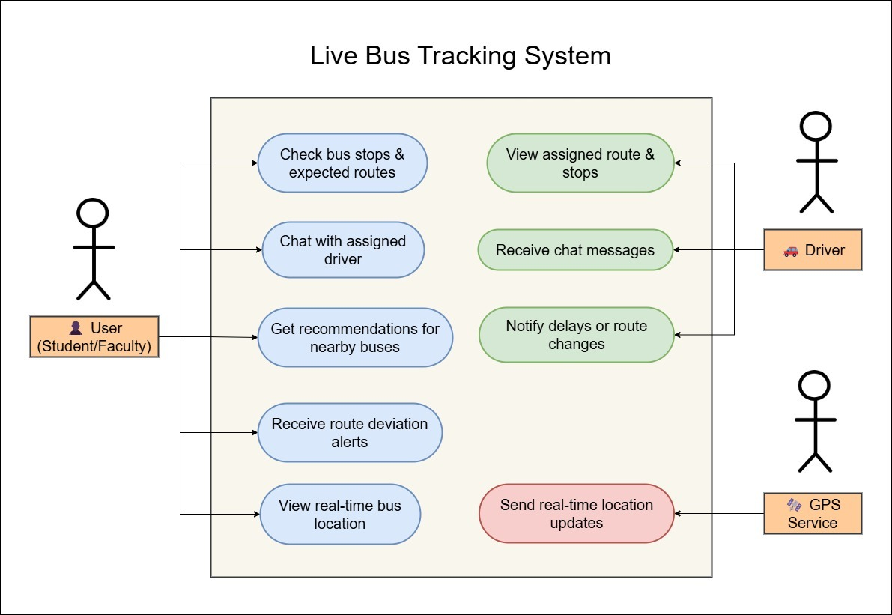
Use Case Diagram

Slide 15
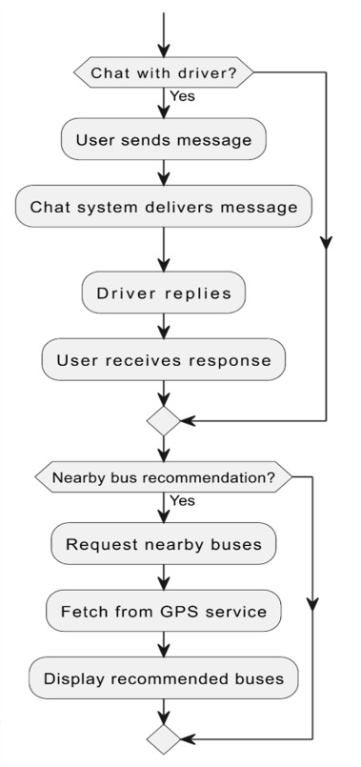
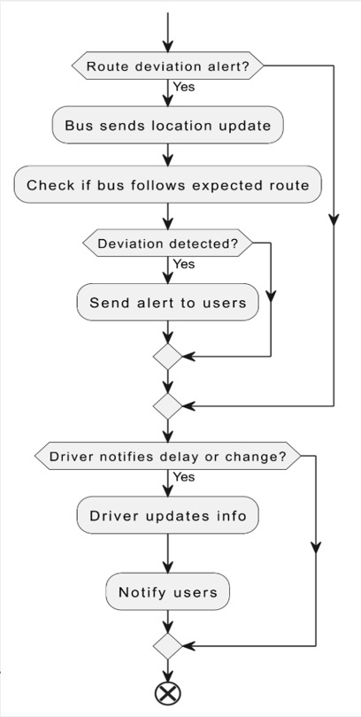
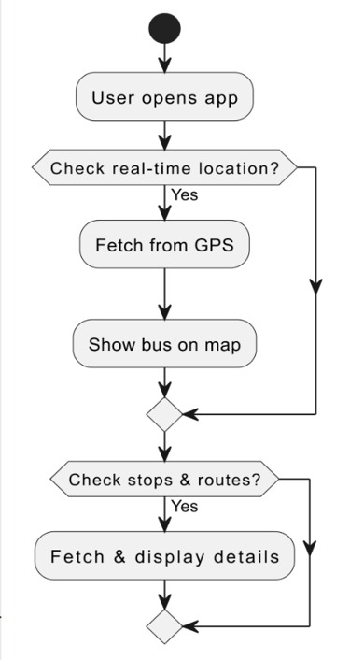
Activity Diagram

Slide 16
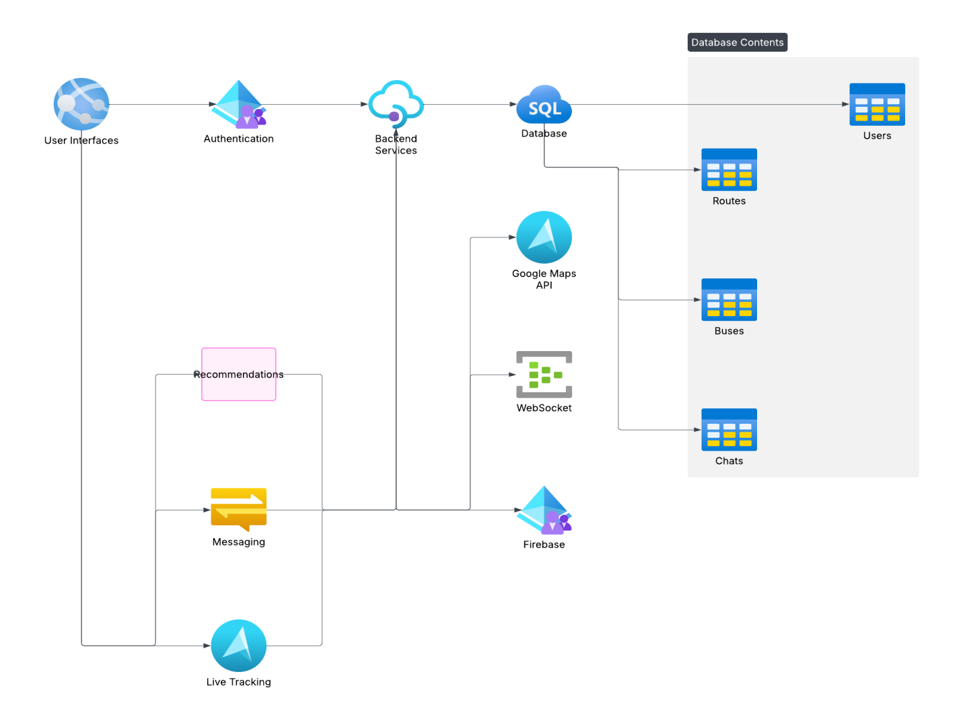
Data Flow Diagram

Slide 17
Modules
Module | Sub-Modules
1. Login / Authentication | Student Login, Driver Login
2. Dashboard (Post Login) | Role-based Student Dashboard, Role-based Driver Dashboard
3. Live Bus Tracking | Real-time Location on Map, GPS Updates and Failover Handling
4. Nearby Bus Recommendation | Location-based Bus Suggestions, Dynamic Suggestions Update
5. Predefined Routes & ETA | Route List and Details, ETA Display and Updates
6. Secure Chat System | Real-time Chat between Student and Driver, Security Testing (SQL Injection, XSS)
7. Route Deviation Alerts | Push Notifications for Deviations, Geo-fencing Logic and Alerts
8. Driver Interface – Route Management | Route Management Interface, Trip Start/End Controls
9. Student Interface – Bus View | Bus Status and Tracking View, Real-time Alerts and ETA Updates
10. Settings/Profile | View and Update Profile, Logout and Change Password Options

Slide 18
Assumptions
Internet Connectivity: Users need a stable connection for real-time features.
GPS Availability: Assumes GPS access for accurate location tracking.
Role-based Access: Different features for students and drivers based on roles.
Real-time Data: Requires constant backend updates for live tracking and notifications.
Offline Functionality: Basic features (routes, offline ETA) should work without internet.
Privacy & Security: Sensitive user data is securely encrypted and protected.
Battery Optimization: The app is designed to minimize battery usage during continuous tracking.

Slide 19
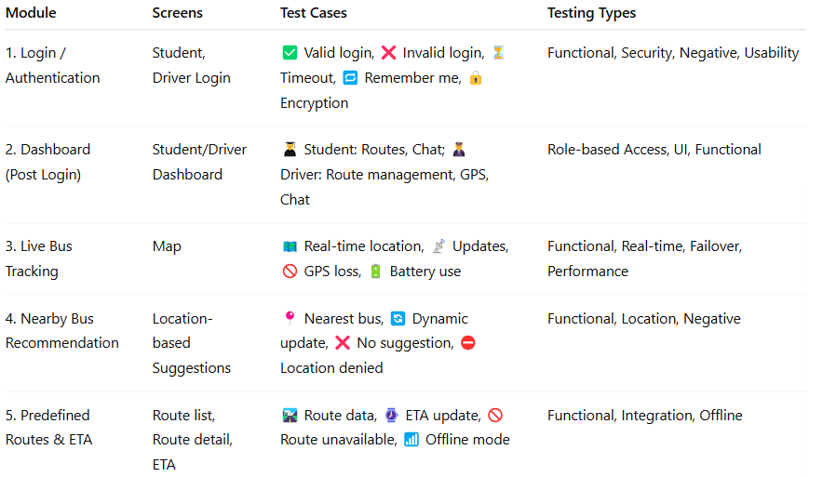
Test Cases

Slide 20
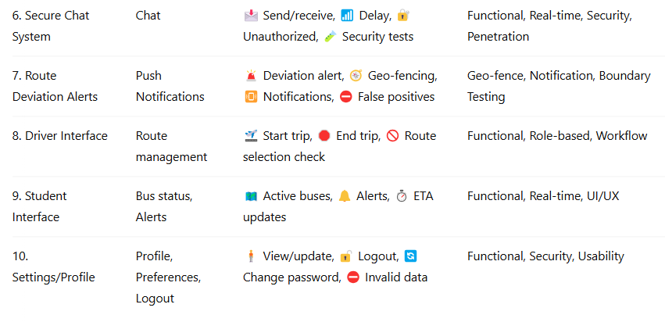
Test Cases

Slide 21
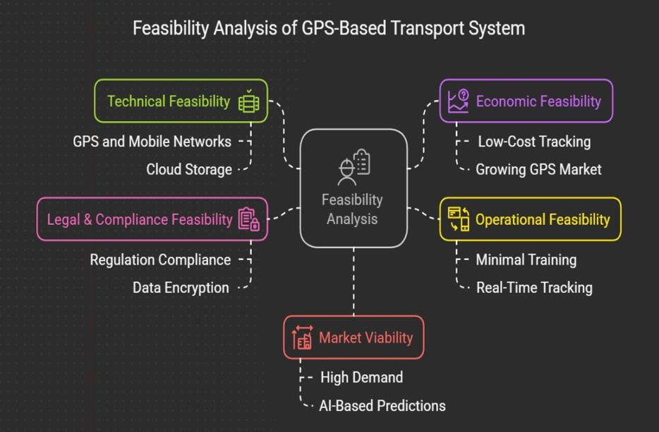
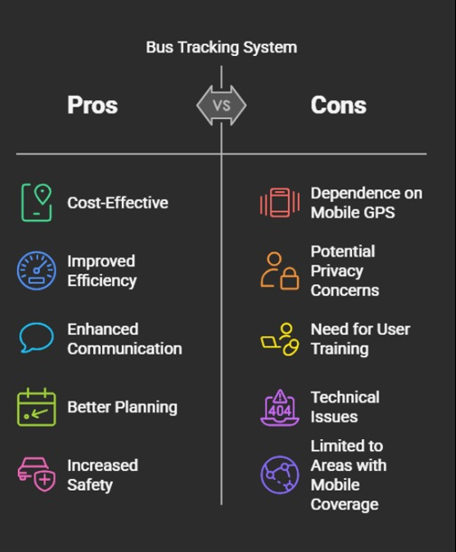
Feasibility and Viability Analysis

Slide 22
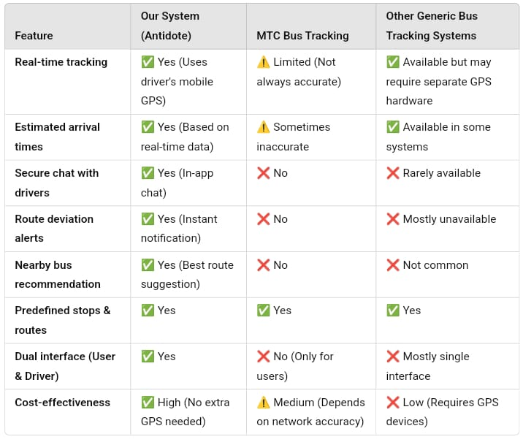
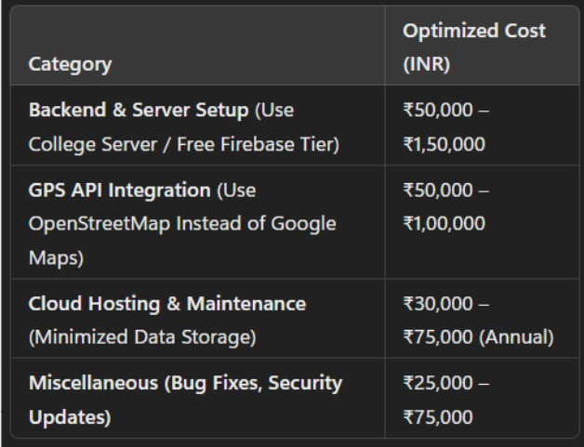
Business Idea
Why invest in us?
Our real-time bus tracking system leverages existing mobile GPS technology to enhance operational efficiency and user satisfaction, offering a cost-effective solution with a potential 4:1 economic return.
Budget Plan

Slide 23
THANK YOU....

